Slide 1
Categorical Exclusions
Including FHWA 23 CFR 771.117, c and d
Grant Wright, Feb. 5th 2020

Slide 2
Abbreviations / Acronyms / TLAs
CE – Categorical Exclusion
CEQ – Council on Environmental Quality
CFR – Code of Federal Regulations
DOT&PF – Department of Transportation & Public Facilities
EA – Environmental Assessment
EIS – Environmental Impact Statement
FHWA – Federal Highway Administration
MOU – Memorandum of Understanding
NEPA – National Environmental Policy Act
QA/QC – Quality Assurance/Quality Control
REM – Regional Environmental Manager
USC – United States Code

Slide 3
Code of Federal Regulations (CFR)
40 CFR - Protection of the Environment
Parts 1500-1508 - National Environmental Policy Act (NEPA)
Part 1508.4 - Categorical Exclusion (CE)
23 CFR - Highways
Chapter I - Federal Highway Administration (FHWA) Department of Transportation (DOT)
Subchapter H - Right-of-way and Environment (parts 710-777)
Part 771 - Environmental Impact and Related Procedures
Part 771.117 - FHWA Categorical Exclusions

Slide 5
Categorical Exclusions - Defined in 40 CFR 1508.4
Categorical exclusion means a category of actions which do not individually or cumulatively have a significant effect on the human environment and which have been found to have no such effect in procedures adopted by a Federal agency in implementation of these regulations (§ 1507.3) and for which, therefore, neither an environmental assessment nor an environmental impact statement is required. An agency may decide in its procedures or otherwise, to prepare environmental assessments for the reasons stated in § 1508.9 even though it is not required to do so. Any procedures under this section shall provide for extraordinary circumstances in which a normally excluded action may have a significant environmental effect.

Slide 6
Categorical Exclusions - Defined in 40 CFR 1508.4
Do not individually or cumulatively have a significant effect on the human environment
Have been found to have no such effect in procedures adopted by a Federal agency
Neither an environmental assessment nor an environmental impact statement is required.

Slide 7
Federal Highway Administration - 23 CFR 771.117 (a)
CEs are actions that meet the definition contained in 40 CFR 1508.4, and, based on FHWA's past experience with similar actions, do not involve significant environmental impacts. They are actions that: Do not induce significant impacts to planned growth or land use for the area; do not require the relocation of significant numbers of people; do not have a significant impact on any natural, cultural, recreational, historic or other resource; do not involve significant air, noise, or water quality impacts; do not have significant impacts on travel patterns; or do not otherwise, either individually or cumulatively, have any significant environmental impacts.

Slide 8
Federal Highway Administration - 23 CFR 771.117 (a)
Do not involve significant environmental impacts.
Do not induce significant impacts to planned growth or land use for the area.
Do not require the relocation of significant numbers of people.
Do not have a significant impact on any natural, cultural, recreational, historic or other resource.
Do not involve significant air, noise, or water quality impacts.
Do not have significant impacts on travel patterns.

Slide 9
Federal Highway Administration - 23 CFR 771.117 (c)
The following actions meet the criteria for CEs in the CEQ regulations (40 CFR 1508.4) and paragraph (a) of this section and normally do not require any further NEPA approvals by the FHWA:
(1) - (30) Listed actions that qualify as CEs.
KNOWN as the c-list

Slide 10
C-list actions
Typical “c” list actions are either non-construction in nature (e.g., planning, grants for training, research programs)
or
involve limited construction activities.
Some activities on the “c” list may require the completion of a CE Documentation Form.
http://www.dot.state.ak.us/stwddes/desenviron/assets/pdf/manual/ch03.pdf

Slide 12
C-List Examples From 2017 FHWA Memorandum
The following activities normally can be processed as CEs under 23 CFR 771.117(c):
Bridge removal. Removal may be a component of a bridge replacement project under 771.117(c)(28). If the bridge is not replaced, it could be considered a CE under 771.117(c)(22).
Construction of new roundabouts or traffic circles are considered traffic operations improvement projects under 771.117(c)(27).
Any highway project action, regardless of location within or outside a highway right-of-way, so long as the project receives less than $5,000,000 (adjusted annually by the Secretary to reflect any increases in the Consumer Price Index) of Federal funds (771.117(c)(23)).2
US DOT FHWA Memorandum May 22, 2017 Information Additional Flexibilities in Categorical Exclusions https://www.environment.fhwa.dot.gov/legislation/nepa/memo_additional-flex.aspx

Slide 13
C-List Examples From 2017 FHWA Memorandum
Widening and improving existing transportation facilities by adding through lanes that add capacity within the existing operational ROW under 771.117(c)(22).
Restoration, rehabilitation, or replacement of retaining walls within the existing operational ROW under 771.117(c)(22).
Bank repairs to protect against stream erosion are considered environmental restoration and pollution abatement actions under 771.117(c)(25).
Restoration, rehabilitation, or replacement of culverts, inlets, drainage pipes, and systems can be CEs under 771.117(c)(22) when done within an existing operational right-of-way or as highway modernization under 771.117(c)(26).

Slide 14
C-List Examples From 2017 FHWA Memorandum
Replacement of existing utility powerline poles for overhead utilities and installation of new poles are considered approval of utility installation projects under 771.117(c)(2).
The FHWA may designate additional (c)-list CEs in the future through rulemaking or the individual State programmatic categorical exclusion agreements.
US DOT FHWA Memorandum May 22, 2017 Information Additional Flexibilities in Categorical Exclusions https://www.environment.fhwa.dot.gov/legislation/nepa/memo_additional-flex.aspx

Slide 15
More Categorical Exclusions - 23 CFR 771.117(d)
Additional actions that meet the criteria for a CE in the CEQ regulations (40 CFR 1508.4) and paragraph (a) of this section may be designated as CEs only after Administration approval unless otherwise authorized under an executed agreement pursuant to paragraph (g) of this section. The applicant must submit documentation that demonstrates that the specific conditions or criteria for these CEs are satisfied, and that significant environmental effects will not result. Examples of such actions include but are not limited to:
(1) - (13) Listed actions that qualify as CEs with additional documentation
KNOWN as the d-list

Slide 16
D-list actions
These example actions may involve a greater likelihood for adverse environmental effects than “c” list actions
and, therefore, require additional documentation that demonstrates that significant environmental effects will not result.
https://www.law.cornell.edu/cfr/text/23/771.117
Prepare a CE Documentation Form (State of AK) to verify compliance with local, state or federal requirements and to ensure the project does not involve unusual circumstances that require an EA or EIS.
http://www.dot.state.ak.us/stwddes/desenviron/assets/pdf/manual/ch03.pdf

Slide 22
Programmatic Categorical Exclusions - 23 CFR 771.117(g)
Procedures for State DOT to make approval determinations on behalf of the FHWA Programmatic Categorical Exclusions (PCEs)
1989 - FHWA Memorandum identified 6 criteria for PCE that State DOTs could use to process and approve CEs without FHWA review.
2015 - Fixing America’s Surface Transportation (FAST) Act clarified that State DOTs can enter into agreements with FHWA to approve PCEs that meet d-list requirements
https://www.environment.fhwa.dot.gov/nepa/programmatic_ce.aspx

Slide 23
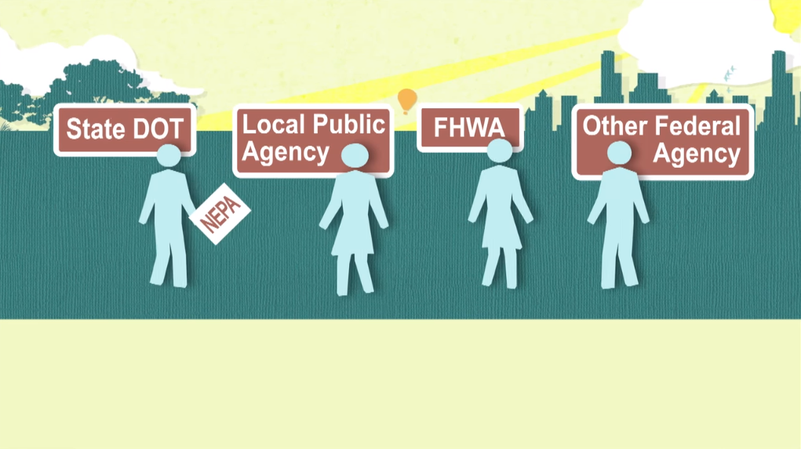

Slide 24
Programmatic Categorical Exclusions - 23 CFR 771.117(g)
The action does not have any significant environmental impacts as described in 23 CFR 771.117(a).
The action does not involve unusual circumstances as described in 23 CFR 771.117(b).
The action does not involve the following:
The acquisition of more than minor amounts of temporary or permanent strips of right-of-way* for construction of such items as clear vision corners and grading. Such acquisitions will not require any commercial or residential displacements.
The use of properties protected by Section 4(f) of the Department of Transportation Act (49 U.S.C. 303).
A determination of adverse effect by the State Historic Preservation Officer.
Any U.S. Coast Guard construction permits or any US Army Corps of Engineers Section 404 permits. * Note: Although a precise definition is not required, one State has defined a minor amount of right-of-way as not more than 10 percent of a parcel for parcels under 10 acres in size, 1 acre for parcels 10 to 100 acres in size and 1 percent of the parcel for parcels greater than 100 acres in size.
Any work in wetlands.
Any work encroaching on a regulatory floodway or any work affecting the base floodplain (100-year flood) elevations of a water course or lake.
Construction in, across or adjacent to a river designated as a component or proposed for inclusion in the National System of Wild and Scenic Rivers published by the US Department of the Interior/US Department of Agriculture.
Any changes in access control.
The use of a temporary road, detour or ramp closure unless the use of such facilities satisfy the following conditions:
Provisions are made for access by local traffic and so posted.
Through-traffic dependent business will not be adversely affected.
The detour or ramp closure, to the extent possible, will not interfere with any local special event or festival.
The temporary road, detour or ramp closure does not substantially change the environmental consequences of the action.
There is no substantial controversy associated with the temporary road, detour, or ramp closure.
Any known hazardous materials sites or previous land uses with potential for hazardous materials remains within the right-of-way.
The action conforms to the Air Quality Implementation Plan which is approved or promulgated by the Environmental Protection Agency in air quality non-attainment areas.
The action is consistent with the State's Coastal Zone Management Plan as determined by the appropriate State agency.
The action occurs in an area where there are no federally listed endangered or threatened species or critical habitat. https://www.environment.fhwa.dot.gov/nepa/documents/memo_ce_documentation.aspx - FHWA Memorandum March 30, 1989 Categorical Exclusion (CE) Documentation and Approval

Slide 25
Programmatic Categorical Exclusion Agreements
Since 1989, FHWA Division Offices and State Departments of Transportation (DOTs) have entered into programmatic agreements that establish procedures for expeditious and efficient approval of Categorical Exclusions (CE), most of which are listed under 23 CFR Part 771.117(d) (commonly known as d-list CEs). Section 1318(d) of MAP-21 enshrined this practice into law and FHWA, through rulemaking, codified it in 23 CFR 771.117(g). Now the FAST Act, Section 1315(b) has clarified that PCE agreements allow State DOTs to approve as CEs, actions not listed in regulation so long as they meet the criteria of a CE. The FHWA Division Office, by agreement with the State DOT, does not require individual project-by-project and approval for the projects which meet the conditions stipulated in the agreements and the State DOT may make a CE approval on FHWA’s behalf. These agreements also establish expectations and responsibilities for the FHWA and State DOT parties involved and can usefully identify processing and documentation expectations for all CE actions, quality control and quality assurance, and FHWA oversight.
https://www.environment.fhwa.dot.gov/nepa/programmatic_ce.aspx

